Slide 1
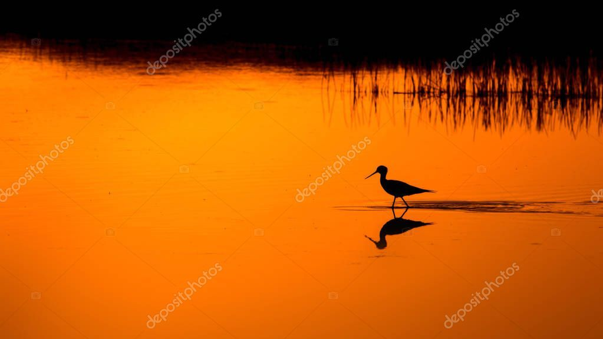
DIGITAL NATURALIST
Using deep learning
Team Members: Aparna Rai.
Banushree DJ
Chandana M
Saloni MP
Neha UK

Slide 2
Introduction:
A naturalist is someone who studies the patterns of nature, identify different kingdom of flora and fauna in the nature, and identify different kind of flora and fauna in the nature.
Being able to identify the flora and fauna around us often leads to an interest in protecting wild species, and collecting and sharing information about the species we see on our travels is very useful for conservation groups like NCC.
Natural history is a domain of inquiry involving organisms, including animals, plants , fungi, in their natural environment , leaning more towards observational than experimental methods of study. A person who studies natural history or well-being is called a naturalist or natural historian.
Natural history encompasses scientific research but is not limited to it. It involves the study of any category of natural objects or organisms.

Slide 3
Overview: Deep-learning-based techniques and methods are becoming popular in digital naturalist studies, as their performance is superior in image analysis fields, such as object detection, image classification and semantic segmentation. Deep learning techniques have achieved state of-the-art performance for automatic segmentation of digital naturalist through multi-model image sensing.
Purpose :
Our aim from the project is to make use of pandas, matplotlib, numpy, tensorflow, keras libraries from python to extract the libraries for deep learning for the flora and fauna prediction for digital naturalist. And in the end, to predict whether the image is of flora or fauna and withdrawing the conclusions.

Slide 4
LITERATURE SURVEY
Image segmentation plays a significant role in naturalist’s image processing as natural images have different diversities.
For this segmentation, they have used scanned images of animals and plants. A technique called image segmentation is presented for segmenting areas of interest in these images.
The proposed algorithm specifies the issues that are associated with segmenting images and allows for fast, strong, and flexible subdivision without requiring true manual tracing.
It is most vastly used for segmentation and classification brought in the accuracy 92% with a split ratio of 80:20 of 309 training set images and 134 testing set images, i.e. 80% of training images and 20% of testing images.

Slide 5
THEORETICAL ANALYSIS
It is important to detect species as early as possible. Manual detection of a species cell is a tiresome task and involves human error, and hence computer-aided mechanisms are applied to obtain better results as compared with manual detection systems.
In deep learning, this is generally done by extracting features through a convolutional neural network (CNN) and then classifying using a fully connected network.

Slide 6
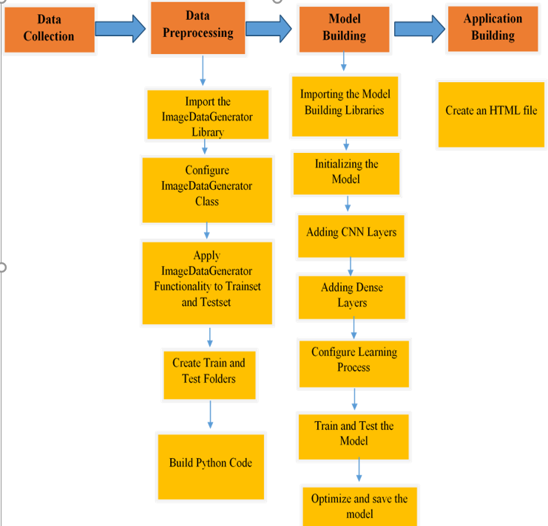
Block Diagram :

Slide 7
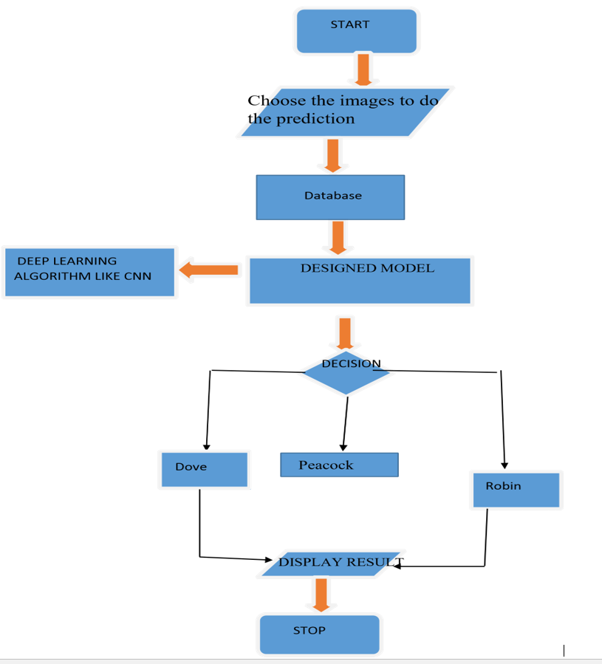
FLOWCHART:

Slide 8
Software Designing
Jupyter Notebook Environment
Spyder
Deep Learning Algorithms
Python(Sequential,Dense,Conv2D,MaxPool2D,Flatten)
HTML
Flask
We developed this digital naturalist prediction by using the Python language, which is a high level programming language along with Deep Learning Algorithm such as CNN. For coding we used the Jupyter Notebook of Anaconda distributions and Spyder. Flask is used as a user interface for the prediction. Hypertext Markup Language (HTML) .

Slide 9
Advantages:
Digital Naturalist detection is easy to implement and understand.
It operate in real-time due to low time complexity.
It is applicable in training and test-time
Deliver invariance with respect to the lesion position scale, and rotation.
Disadvantages:
It produces correlated images.
It easily generate anatomically incorrect examples.

Slide 10
APPLICATIONS:
“Digital Naturalist Detection using Convolutional Neural Networks” simplifies the management process of identifying and feature down flora and fauna data by deploying a web interface to the users.
Fast processing and immediate results with high security.
Minimizing human effort and cost efficient databases.
Navigation through the site is easy.

Slide 11
FUTURE SCOPE:
There is a wide scope for future implementation of “Digital Naturalists Detection using Convolutional Neural Networks” towards an interesting experience of modern technologies. Digital Platform is ‘one stop shops’ for all kinds of Naturalists to serve the domestic and international users at any time, any moment and anywhere in any parts of the world.
Not being sticky to make packages within India only, it can be global - a “global platform” through a comprehensive. In present days, modern technologies have made the identification more pleasure comprising speed with comfort. So, people are not willing to be bound within only a small geographical area, so there is place to make them experience the taste of “Global Platform”.

Slide 12
Conclusion:
This projects consists of the details about the model which was used for the detection of digital naturalists using the species images from the wild life and the species with flora part and with faun part will be displayed as well. From the resultant graphs, it is proven that the accuracy of the model has reached good level, if it is deployed in the real-time scenario then it will help many people in distinguishing between both without wasting the money on various machines. If the image is confirmed by the model, then the person can know the feature of the species. It can be the best way of practice for people to save money.

Slide 13
Thank You

